Slide 1
Community Public Meeting
Colorado Risk MAP COMMUNITY FIRM and FIS Update
Location
Date & Time

Slide 2
Purpose for Our Meeting
Provide background on why there is a study and who is involved.
Brief summary of the study process & timeline
Explain mapping results
General insurance & development implications
Resources & next steps
Open discussion with you

Slide 3
Outline
NFIP & Background
Study Review & Timeline
Results & Mapping
Insurance, Appeals & Resources

Slide 4
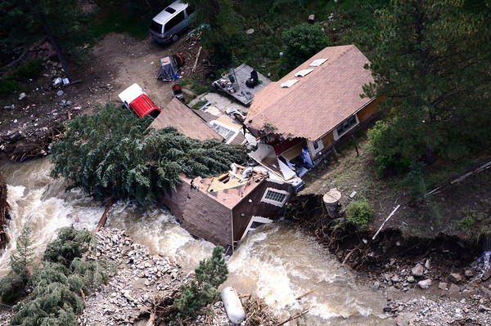
Why is this important?
Updated Risk Information
Floods are devastating
Mapped flood risk is not static
Updated data for hazard mitigation
Help protect life, health, and safety
Communities Participate in NFIP
Building requirements
Insurance requirements
Keep flood risk current (44 CFR 65.3.c)
Inform public of risk
Notes:
This presentation is meant to answer several questions that typically come up and get everyone on the same page
Emphasize flood risk is important and can affect lives. It is also not static, which is why these studies occur.
Describe that the communities participate in the NFIP so that they can buy flood insurance and receive federal assistance. Communities who participate have to follow certain requirements.

Slide 5
NFIP Refresher
Voluntary Program
Allows homeowners to buy insurance based on Zones and be eligible for federal assistance
Federal Program
Overseen by FEMA and Partners
Managed by Communities
Enforced by lenders
Engineers determine risk
Used to determine requirements
Allows discount for less risk
Notes:
Talk through NFIP points.

Slide 6
Roles
Partnership
Community Officials
State (CWCB)
FEMA
Private Stakeholders
Administer NFIP
Communicate Risk and Changes to it
Manage Construction
Flood Risk Adaptation
Enforcement of Regulations
Identification of changed risk
Public Communication
Responding to Community Request to Update FIRMs
Initiated Risk Identification Updates
Community Assistance
FEMA Partner
Funding for Study
Including new study on FIRMs
NFIP
Work with community officials to update information
Notes:
Describe what the roles are for all involved.

Slide 7
Outline
NFIP & Background
Study Review & Timeline
Results & Mapping
Insurance, Appeals & Resources

Slide 8
Study Extents
Insert Map of Project Area
consult county storymap on website as well

Slide 9
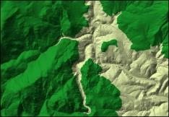
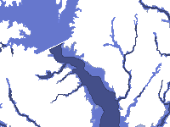
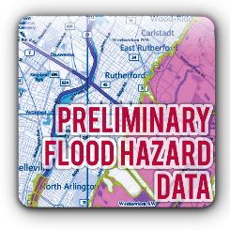
Process & Data Overview
Terrain
Survey
Hydrology
Hydraulics
Floodplains
Available upon request
(2ft contours & DEM)
On website for download
On website for download and interactive viewer
On website for download
On website for download and interactive viewer
Provided to communities

Slide 10
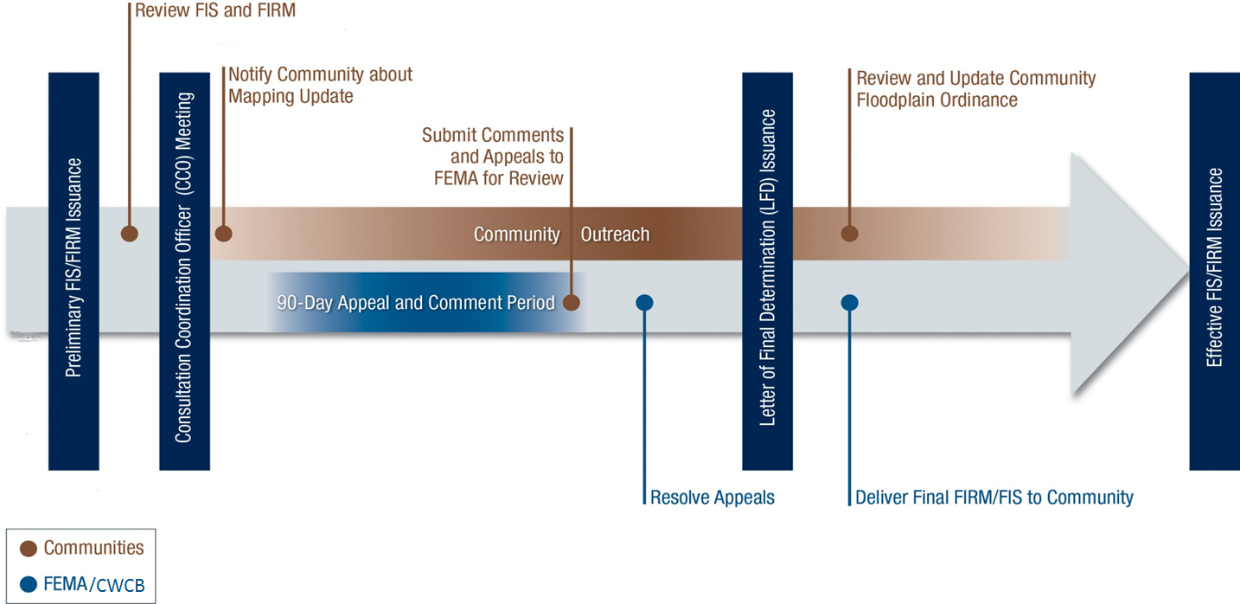
Regulatory Schedule
Approximate timeline in months after prelim
+8 to 12
Depends On Appeals
+14 to +18
Month
0
+1
+2
+7
6 months
+4

Slide 11
Outline
NFIP & Background
Study Review & Timeline
Results & Mapping
Insurance, Appeals & Resources

Slide 12
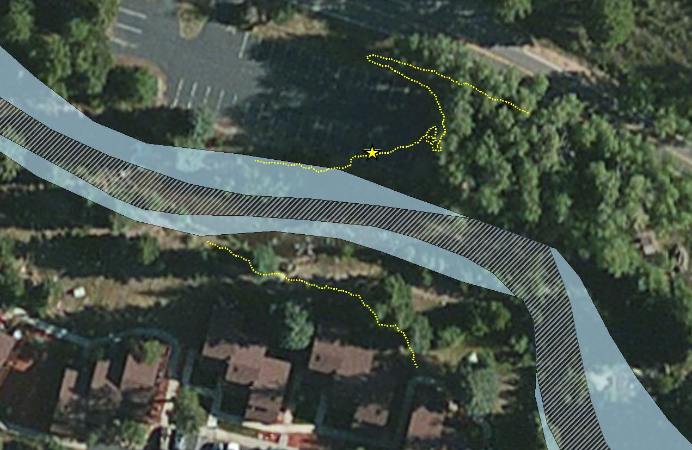
Do Results Depict Actual Flooding?
Actual floods can see different results every time
Dam breaks
Bridge and culvert clogging
Debris
Models are based on conditions from topographic data and survey
Models are based on best available information at the time
Notes:
Describe why results of this study may be different.

Slide 13
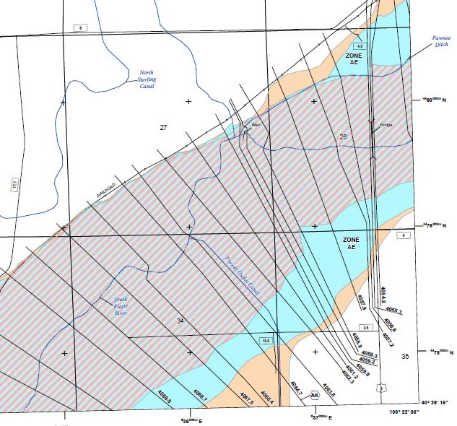
Flood Insurance Rate Maps Refresher
Used to rate flood insurance
Show Flood Risk
1% Annual Chance Flood
0.2% Annual Chance Flood
Available Online:
FEMA Map Service Center (MSC)
FEMA National Flood Hazard Layer (NFHL)
Notes:
Show what different symbols mean on FIRMs
Describe what 1% flood and 0.2% flood are.
Floodway discussion to come later.

Slide 14
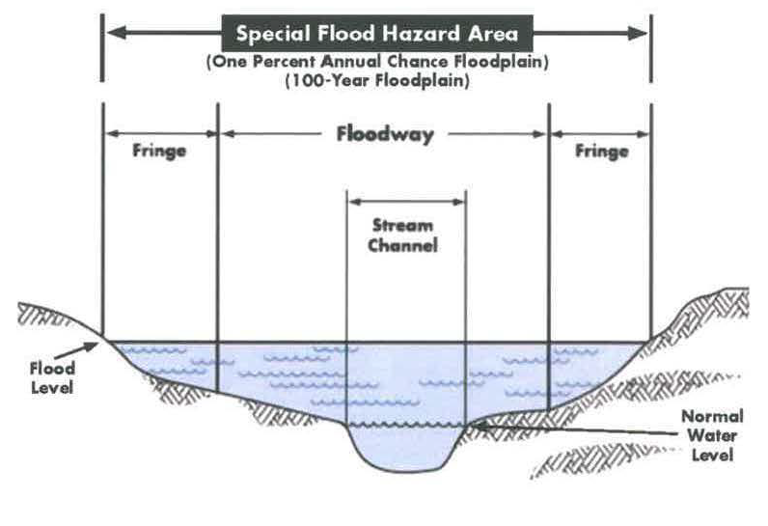
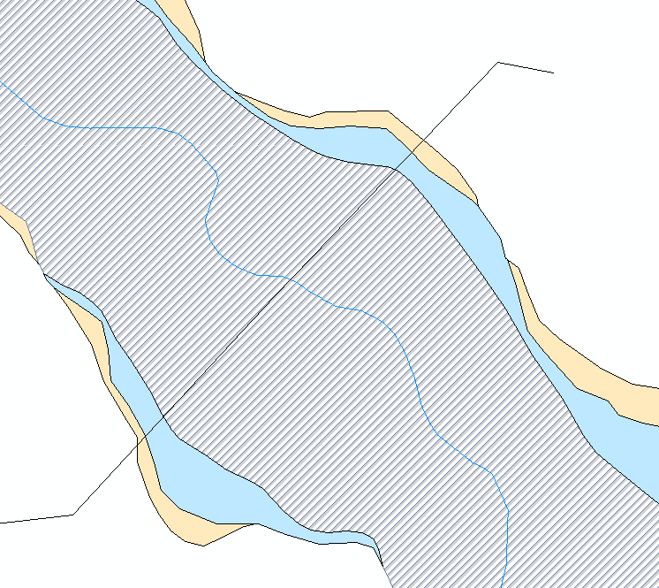
Floodways
Implications of Floodway vs. Floodplain
Don’t Impact Your Neighbor
Notes:
Regulatory floodway is a “don’t impact your neighbor” condition. Developers and homeowners are supposed to work together to show that cumulative development does not impact anyone by more than 0.5’ in Colorado. The project team conducted an analysis to show where limits are that would and would not impact people by more than 0.5’ if development occurs. This allows people in the flood fringe to develop by elevating and not conducting an engineering study. Development in the floodway is required to show that impacts will not occur due to development.

Slide 15
Structure Counts
Insert Table of Structure Count Changes
consult county storymap on website as well
*** Numbers are approximate building counts***

Slide 16
Who is at risk of flooding?
So…
Line on a map
Best engineering data and judgment used
Scientific process allows for changes
New information
Changed information
BUT
You may still be at risk of flooding
Notes:
Reinforce that others could be at risk of flooding, the best engineering data has been used, and the process allows for updates and new information (to be described in the next slide).
Discuss that we understand the impacts of identifying this risk and that the number of impacted structures are shown below.

Slide 17
Outline
NFIP & Background
Study Review & Timeline
Results & Mapping
Insurance, Appeals & Resources

Slide 18
Homeowner’s Insurance
Where flood risk changed: requirements aren’t new, risk just updated
NFIP requires for federally backed mortgages in Special Flood Hazard Areas (SFHAs): Zone A, AE, AH, AO
Banks can require anywhere
Flood insurance available anywhere in County Could still flood, line on map doesn’t stop flooding
Insurance is required for federal assistance after floods.
New Zones go into effect with effective FIRMs, not before
Grandfather information
Notes:
Insurance – talk through bullets
When considering your flood insurance options, it’s best to consider both whether grandfathering your property following the map revision within the 1st year and getting an elevation certificate to weigh your options. Once an elevation certificate is done, you can best know your options. If you don’t wish to pay for an elevation certificate than getting flood insurance within the 12 months following the map revision is crucial whether your have a mortgage or not. If you don’t, then if flood insurance is required you will be required to get an elevation certificate for rating purposes. There are three ways to rate a policy either with an elevation certificate, newly mapped rates that transition to grandfathered rates eventually. If the home is built in compliance according to the flood maps in place at the time of construction, then a grandfathered policy can be obtained at any time. If the home was built before the community joined the NFIP, then it’s best to buy a flood policy before or within 12 months following the map revision being finalized even when there is no mortgage on the property. A lender will require a flood insurance policy but with no mortgage no notice will be given to a property owner other than the community letters sent to homeowners prior to the map revisions.

Slide 19
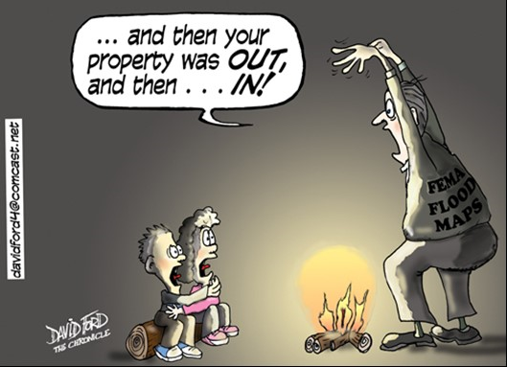
Flood Insurance – Map Changes
Newly mapped into a high risk area
Get preferred risk policy before effective
Removed from the high risk area
Does not mean no risk
Convert policy after effective
Change in Base Flood Elevation
Grandfathering
No change to Flood Risk
LOMA/LOMR Option May be Available

Slide 20
Development Implications
Community ordinance specifies what is required
Different requirement in a floodway and a non-floodway
Community may adopt as best available data
Use the most restrictive of old and new until final
Floodplain Administrator
Notes:
development – talk through bullets

Slide 21
Can results be changed?
Technical data
Survey or topographic data
New analysis
Mechanism
Appeal preliminary maps
Letter of Map Revision (LOMR) later
Letter of Map Amendment later
Will need elevation certificate
Community has been included in project correspondence
Notes:
Discuss the appeal and comment period and what the differences are between the two and who to coordinate with.

Slide 22
Where do Appeals go?
Appeals must be coordinated with community and submitted electronically within the 90-day period to: FEMA at R8commentsandappeals@fema.dhs.gov and CWCB at Thuy.Patton@state.co.us

Slide 23
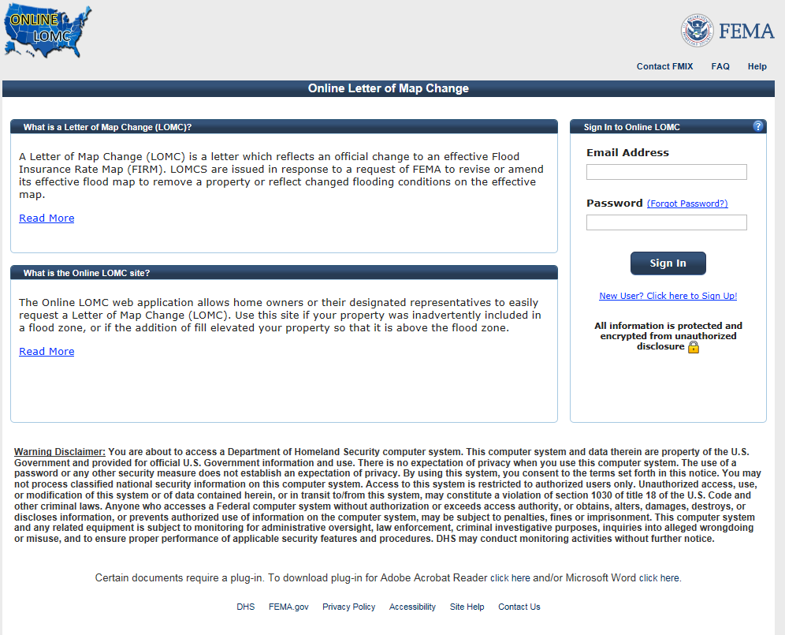
LOMA/LOMR
Submit LOMRs as usual
Tie into preliminary
LOMRs will not go effective until after physical map revision
LOMA
Could be revalidated with SOMA
Submit new after effective

Slide 24
Other Resources
Contacts (Shown on last slide)
Local Floodplain Administrator
State Study Leads
Flood Insurance Representative
FEMA Area Representative
Flood Smart
www.floodsmart.gov
(800) 427-4661
CWCB Flood Page - cwcb.state.co.us/water-management/flood/Pages/main.asp
Website (next)
Notes:
Discuss that multiple resources are available for questions and more information. This presentation will be available if anyone needs these links.

Slide 25
Project Website
www.coloradohazardmapping.com
Notes:
Show data on CHAMP site

Slide 26
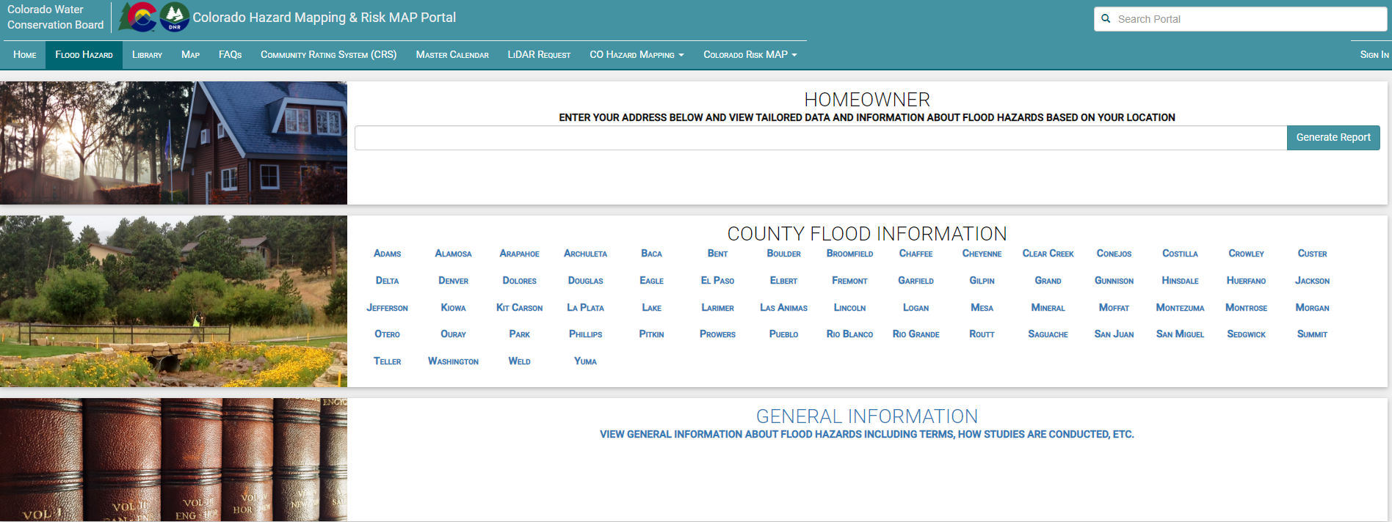
Project Website
Detailed study info
Tutorial & fact sheets
Notes:
Show data on CHAMP site

Slide 27
Conclusion
Results show risk that is already there!
Data will be used for Flood Insurance Rate Maps
Floodplains are not “Effective” until FIRMs are released
Ask questions
Notes:
Reinforce that the main takeaways are:
Resources are available at this meeting for questions. Make sure to ask if you have them.
FIRMs will be used to rate flood insurance once they become effective. If you are in or near a Zone A, make sure you understand what that means and what to do.
Flood insurance requirements will not change until FIRMs are effective.
Results show risk. If you are in or near a mapped floodplain, you could be at a greater risk of flooding. If you are outside of a mapped floodplain, there is still flood potential.

Slide 28
Project Contacts
Community
State & Federal
Community to include | Matt Buddie Floodplain Management & Insurance Specialist Matt.Buddie@fema.dhs.gov; 303) 842-4710
 | Doug Mahan, CFM Community Assistance Coordinator, CWCB Doug.mahan@state.co.us; (303) 866-3441 x3221
 | Thuy Patton, CFM Floodplain Mapping Program Manager, CWCB thuy.patton@state.co.us; (303) 866-3441 x3230
 | Chris Gaynes Civil Engineer, FEMA Region VIII christine.gaynes@fema.dhs.gov; 202.480.1265
Notes:
Thuy

