Slide 1
Community Rating System
Overview for Community Officials
Notes:
This PowerPoint is intended for presentation to community leadership officials, such as the Mayor, City Council, or County Board of Commissioners by the community’s Floodplain Administrator. Extensive explanation of the contents of each slide is included in the Notes section for each slide.
This presentation assumes that the Floodplain Administrator, or the person giving the presentation, has reviewed the CWCB’s CRS website, and using the tools provided there (Flowchart and Quick Check), determined that joining the CRS may be an option for the community. Slides towards the end of the presentation contain information resulting from those considerations.

Slide 2
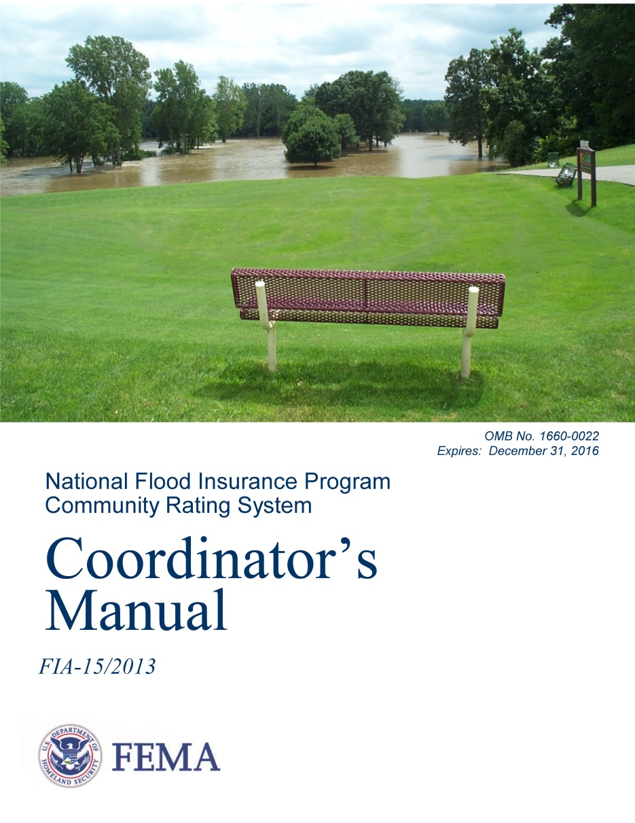
What is the Community Rating System (CRS)?
Voluntary incentive program through National Flood Insurance Program (NFIP)
Rewards communities that exceed NFIP minimum floodplain management standards
Notes:
The NFIP’s CRS is a voluntary incentive program that recognizes communities for implementing floodplain management practices that exceed the Federal minimum requirements of the NFIP to provide protection from flooding.
Participation in the CRS is voluntary. By participating, communities earn credit points that determine classifications.

Slide 3
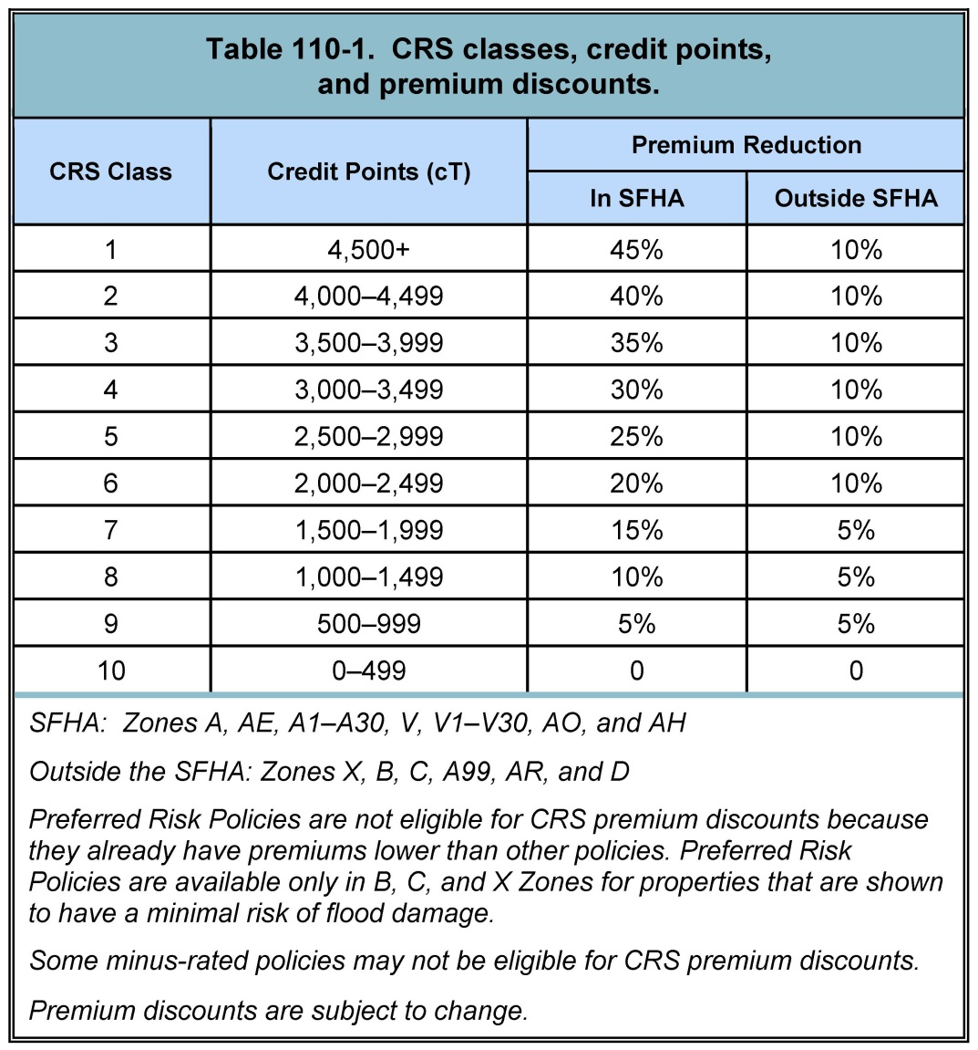
CRS Classes with Policyholder Premium Discounts
More proactive flood risk reduction efforts
Lower flood insurance premiums
=
Notes:
There are 10 CRS Classes: Class 1 requires the most credit points and provides the largest flood insurance premium reduction for policyholders located within the Special Flood Hazard Area (45%), while Class 10 means the community does not participate in the CRS or has not earned the minimum required credit points, and residents receive no premium reduction.

Slide 4
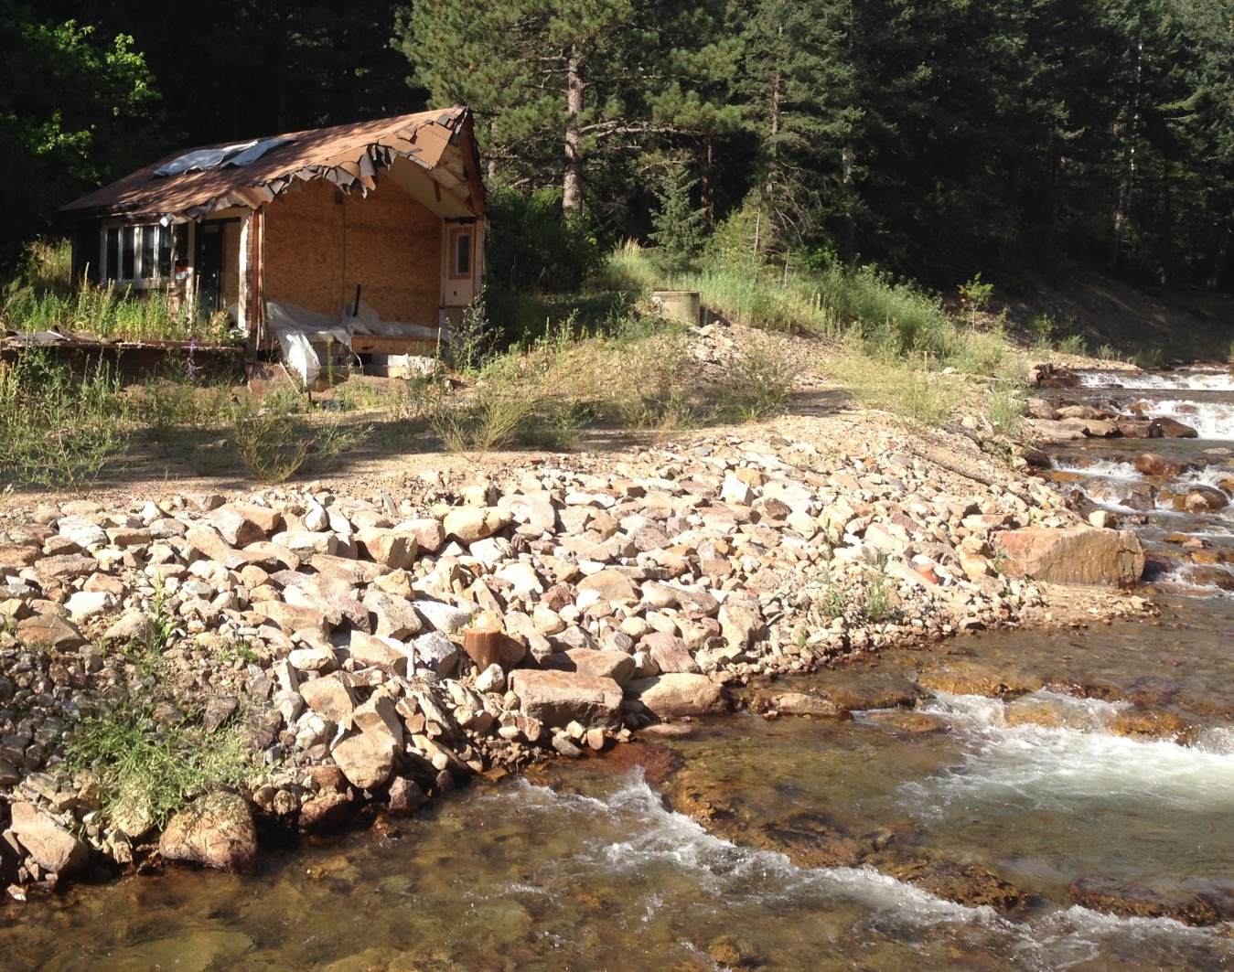
Goals of the CRS
Reduce and avoid flood damage to insurable property
Strengthen and support the insurance aspects of the NFIP
Encourage comprehensive floodplain and stormwater management
Home damaged by 2013 flooding along James Creek. Source: AECOM.
Notes:
The CRS provides both incentives and tools to further the NFIP’s goals to provide insurance to property owners, to encourage flood loss reduction activities by communities, and to save taxpayers’ money. In exchange for a community’s proactive efforts to reduce flood risk, policyholders can receive reduced flood insurance premiums for buildings in the community. These reduced premiums reflect the reduced flood risk resulting from community efforts toward achieving the three CRS goals:
Goal 1: The CRS supports the NFIP by encouraging communities to work toward minimizing flood losses both inside and outside of mapped floodplains by:
Reducing the exposure of existing buildings to flood damage, especially properties that are subject to repetitive flood losses.
Protecting new buildings and their contents from known and future local flood hazards.
Standards higher than the NFIP’s minimums may be needed to accomplish these tasks. The CRS encourages communities to map and provide regulatory flood data for all their flood hazards, to use that data in their programs and to share it with all users and inquirers.
Goal 2: The CRS recognizes communities whose activities generate information that enables accurate actuarial rating of flood insurance policies. Communities are encouraged to:
Implement mapping and information programs to help assess individual property risk and reduce repetitive flood losses.
Help expand the policy base by making their residents aware of their flood risk so that they purchase and maintain flood insurance policies.
Goal 3: The CRS encourages communities to implement comprehensive local floodplain management programs using all available tools. Such comprehensive programs usually include efforts beyond those strictly geared towards the protection of insurable property. The CRS recognizes local efforts that:
Protect lives
Further public health, safety, and welfare
Minimize damage and disruption to infrastructure and critical facilities
Preserve and restore the natural functions and resources of floodplains and coastal areas
Ensure that new development does not cause adverse impacts elsewhere in the watershed or on other properties
A comprehensive approach includes planning, public information, regulations, financial support, open space protection, public work activities, emergency management, and other appropriate techniques.

Slide 5
Benefits of the CRS
Safer, more resilient communities
Enhanced public safety
Protect the environment
Money stays in the community
Reduced flood losses
Lower flood insurance premiums
Communities receive recognition for their flood risk reduction efforts
Instills pride in the community
Notes:
Participating in the CRS enables communities to:
Lower flood insurance premiums so that more money stays in the community
Ensure residents are reminded every time they pay their reduced flood insurance premium that their community is working to protect them from flood losses
Enhance public safety
Reduce damage to property and public infrastructure
Avoid economic disruption and losses
Protect the environment
Create a better organized, more formal, institutionalized floodplain management system
Provide a method for evaluating the effectiveness of its efforts against a nationally recognized benchmark
Provide access to free technical assistance for designating and implementing some activities
Build a knowledgeable constituency interested in supporting and improving flood protection measures through public information activities
Instill community pride

Slide 6
How much work is the CRS?
Designate CRS Coordinator
Often assigned to Floodplain Administrator
Implementing creditable activities
Several community departments could be involved
Recertification/ Verification process
Staff time increases with each class
Join CRS
Verification Visit
Annual
Recertification
5-Year Cycle Verification
*Annual
Recertification
Annual
Recertification
Annual
Recertification
*For Classes 1-5, Cycle Verification visits increase to a 3-year interval.
1
2
3*
4
5
6
Notes:
Communities should prepare and implement those activities which best deal with their local problems, whether or not they are creditable under the CRS. Few, if any, of the CRS activities will produce premium reductions equal to or greater than the cost of their implementation. In considering whether to undertake a new floodplain management activity, a community must consider all of the benefits the activity will provide (not just insurance premium reductions) to determine whether it is worth implementing.
No fee is charged for a community to apply for participation in the CRS. The only costs the community incurs are those of implementing creditable floodplain management activities and the staff time needed to document those activities and prepare for and participate in the recertification process and verification visits.
Explanation of graphic:
After joining CRS, the following timeline can be expected:
Year 1 – Initial Verification visit from ISO Representative
Year 2 – Annual Recertification – this is a self-certification that the community is still implementing the programs that led to the current Class rating
Year 3 – Annual Recertification (For Class 6 and below. Once Class 5 or above are attained, Year 3 is a Cycle Verification visit)
Year 4 – Annual Recertification
Year 5 – Cycle Verification – a verification visit from ISO to confirm that the community is still implementing the programs the led to the current Class rating, also typically taken as an opportunity to submit for additional activities to attain a higher Class rating.
Year 6 – Annual Recertification.
The cycle continues…

Slide 7
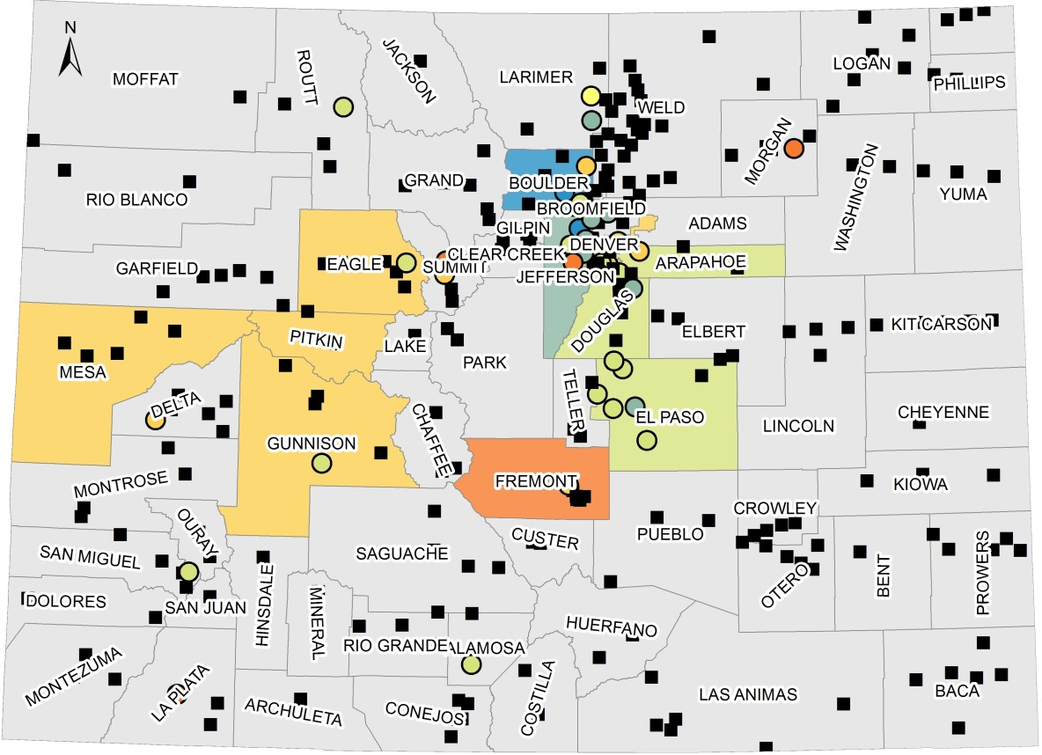
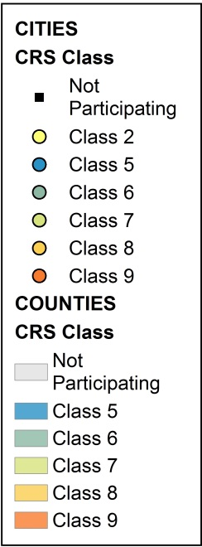
What are other Colorado Communities doing?
Of 334 Colorado communities, 46 participate in the CRS.
Participating communities span the state:
Brush, Class 9
Mesa County, Class 8
Alamosa, Class 7
Boulder Co., Class 5
Fort Collins, Class 2
Increasing participation is one of CWCB’s resiliency goals.
Source: Community Rating System Eligible Communities Table, Effective May 1, 2016. http://www.fema.gov/media-library-data/1458756801023-311019d76271533f6b21ce505df7bd3c/20_crs_508_apr2016.pdf
Notes:
Communities = Cities, Towns, and Unincorporated Counties

Slide 8
Minimum Requirements (1 of 3)
Be in the Regular Phase of the NFIP for at least one year.
We have been in the Regular Phase for XX years.
Be in full compliance with NFIP
We will need to have/have had a Community Assistance Visit to verify this.
Notes:
PRESENTER: Replace red text with appropriate information for your community.
To become and continue to be a Class 9 or better, a community must meet the following:
The community must have been in the Regular Phase of the NFIP for at least one year.
The community must be in full compliance with the minimum requirements of the NFIP. There must be correspondence from the FEMA Region VIII Office stating that the community is in full compliance with the NFIP. The correspondence must have been sent within six months of the initial CRS verification visit. The FEMA Regional Office or State NFIP Coordinator may need to conduct a Community Assistance Visit if neither has been in the community recently. If a community is determined at any time to be in less-then-full compliance, it will retrograde to a CRS Class 10.

Slide 9
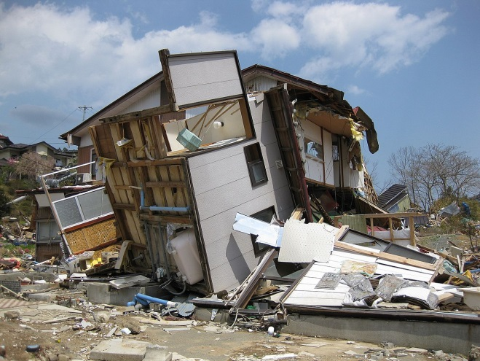
Minimum Requirements (2 of 3)
Maintain FEMA Elevation Certificates on buildings in the SFHA
Our community has/does not have ECs on file.
Meet Repetitive Loss criteria
Our community has XX Repetitive Loss structures.
Notes:
PRESENTER: Replace red text with appropriate information for your community.
To become and continue to be a Class 9 or better, a community must meet the following:
The community must maintain FEMA Elevation Certificates on all new buildings and substantial improvements constructed in the Special Flood Hazard Area (SFHA) after the community applies for CRS credit. This is explained in Activity 310 (Elevation Certificates) of the CRS Manual.
A community’s permit files must include an official record that all new or substantially improved buildings in the SFHA are properly elevated.
FEMA encourages use of its Elevation Certificate form since CRS requires that form and it can be used to obtain flood insurance.
If a community does not allow development within the Special Flood Hazard Area, there would be no elevation certificates and the community would document compliance with CRS requirements through a letter stating that no development is permitted.
A Repetitive Loss property is a single property with two or more flood insurance losses that exceeded $1,000 within the last 10 years. If there are one or more repetitive loss properties in the community, the community must take certain actions. These actions, which are described in Sections 501-504 of CRS Manual, include reviewing and updating the list of repetitive loss properties, mapping repetitive loss areas, describing the causes of the losses, and sending an outreach project to those areas each year. A community with 10 or more repetitive loss properties must also prepare a plan for addressing its repetitive flood problem.

Slide 10
Minimum Requirements (3 of 3)
Maintain flood insurance policies on community-owned buildings in the SFHA
We do/do not have insurance on our buildings.
Demonstrate enough points to obtain Class 9
The Quick Check shows that we do/do not have enough points.
Notes:
PRESENTER: Replace red text with appropriate information for your community.
To become and continue to be a Class 9 or better, a community must meet the following:
The community must maintain all flood insurance policies that it has been required to carry on properties owned by the community. The community’s chief executive officer signs the verification visit cover sheet, which includes a statement that the signer certifies that the community has all the flood insurance policies that it has been required to maintain on properties owned by the community.
Demonstrate enough points to warrant a Class 9.

Slide 11
Steps towards Participation
Submit Letter of Interest & Quick Check to FEMA Region VIII
Prepare needed CRS documentation
Community Certifications
Activity documentation
Participate in initial verification visit
Notes:
A letter of interest that:
States that the community is interested in joining the CRS. Designates the community’s CRS Coordinator.
States that the community will cooperate with the verification process.
The letter is signed by the community’s chief executive officer (CEO)

Slide 12
Questions?

